Slide 1
Ordination with unifrac distance matrix
With various age, gender subgroups and food tree levels

Slide 2
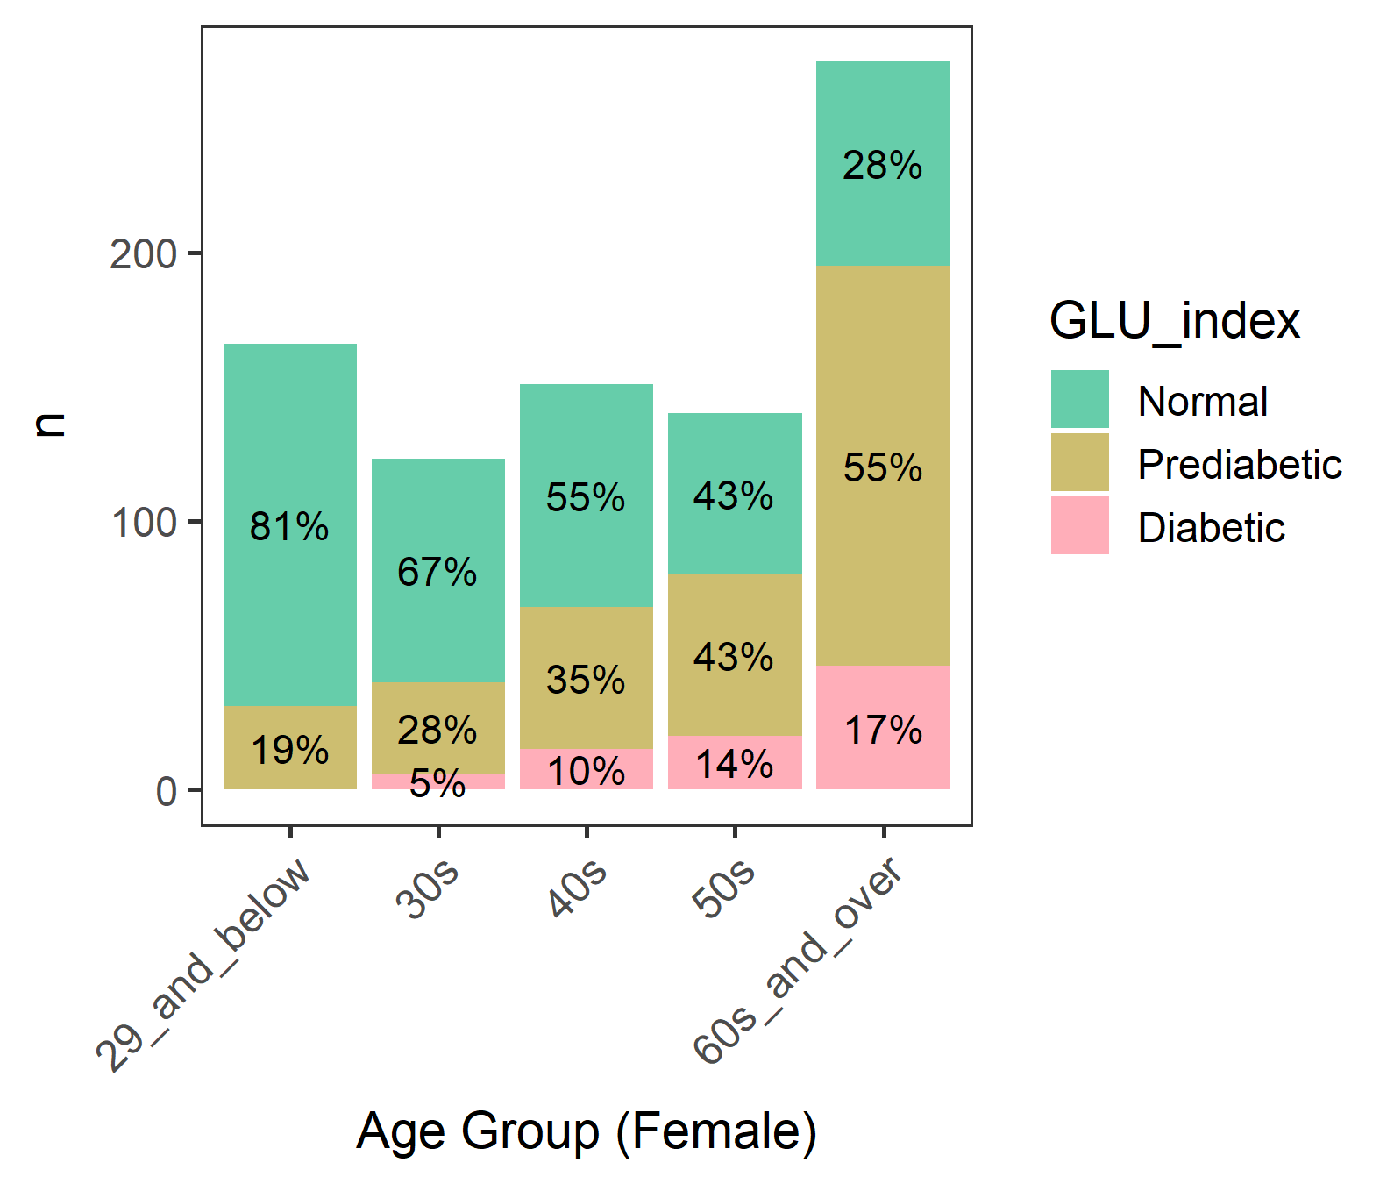
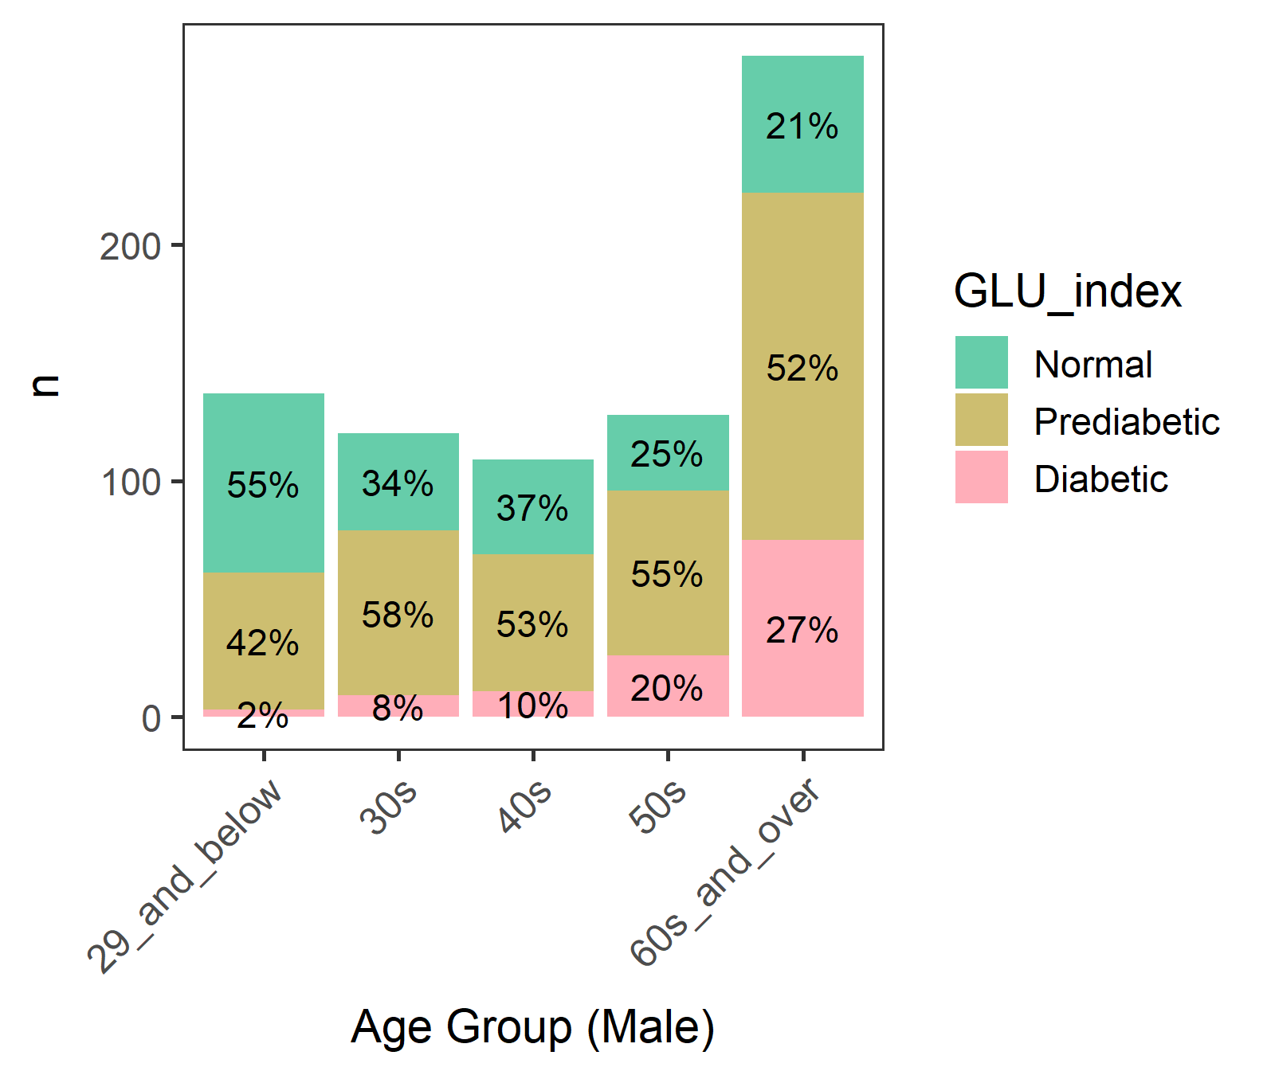
Diabetic groups by gender and age
We focused on male >= 60 where diabetes is most common

Slide 3
Male - Diabetic groups by age
A lot of 80 year-olds. Perhaps 80 or older were grouped.
(Age) 60 61 62 63 64 65 66 67 68 69 70 71 72 73 74 75 76 77 78 79 80
(n) 17 22 14 12 13 17 14 11 8 13 15 11 11 9 12 11 9 7 6 5 43
80+ may not be eating as freely as others due to nursing homes or meal assistance.
But their Normal/Prediabetic/Diabetics percentages are similar to other ages, so should be OK…

Slide 4
Male with age 60-79 (n=237)

Slide 5
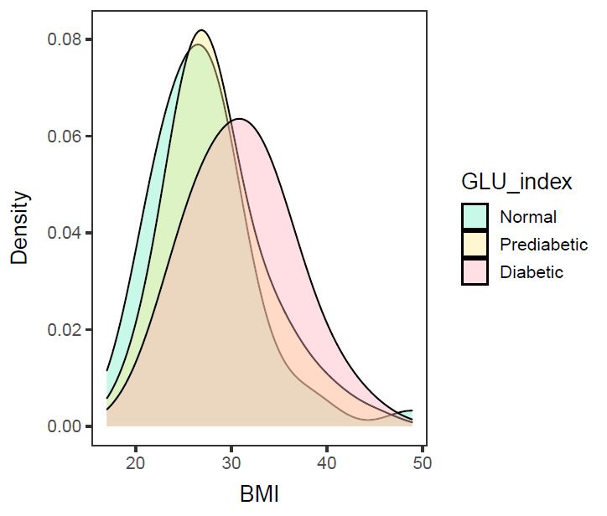
Male in 60-79, BMI (n=234; 3 missing BMI)
ANOVA – significant (p-value= 0.000481).
Diabetic is different from Normal and Prediabetic, but
Normal and Prediabetic are not different.
data: df$BMXBMI and df$GLU_index
Normal Prediabetic
Prediabetic 0.128 -
Diabetic 0.00056 0.00499
Diabetic group has a higher mean BMI than Prediabetic and Normal group.

Slide 6
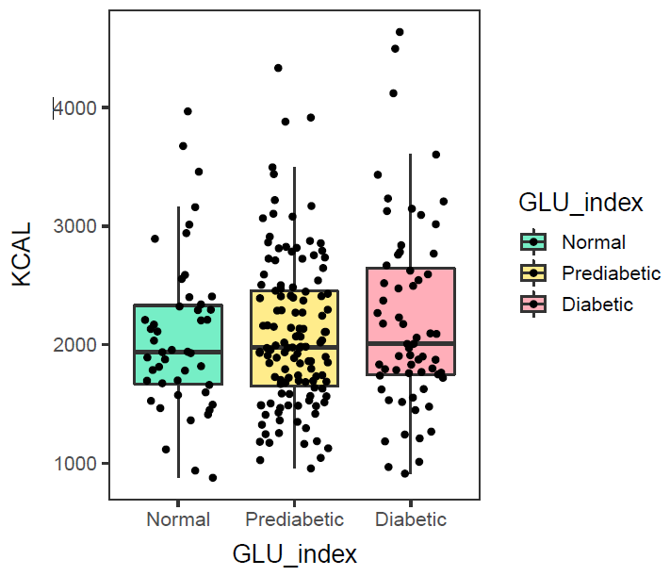
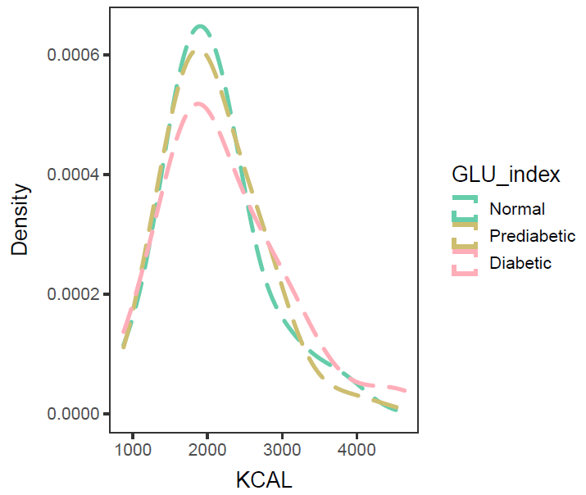
Male in 60-79, KCAL (n=237)
ANOVA – not significant (p-value=0.457).
No need to control KCAL intake.
Calorie intake of Normal, Prediabetic, and Diabetic groups are not different.

Slide 7
Correlation between Axis values and variables (foods)

Slide 8
With WEIGHTED Unifrac Distance

Slide 9
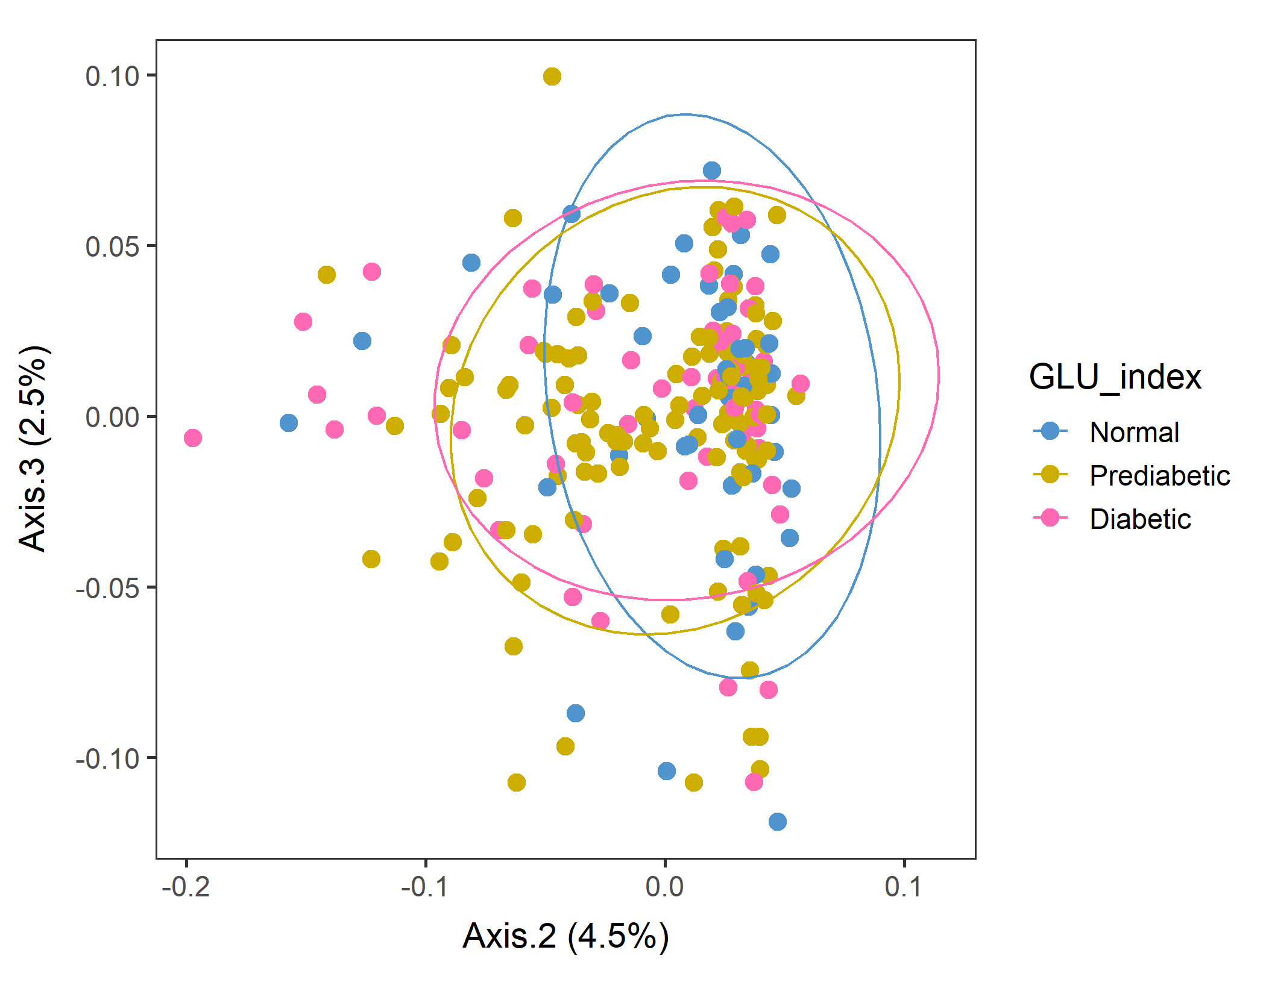
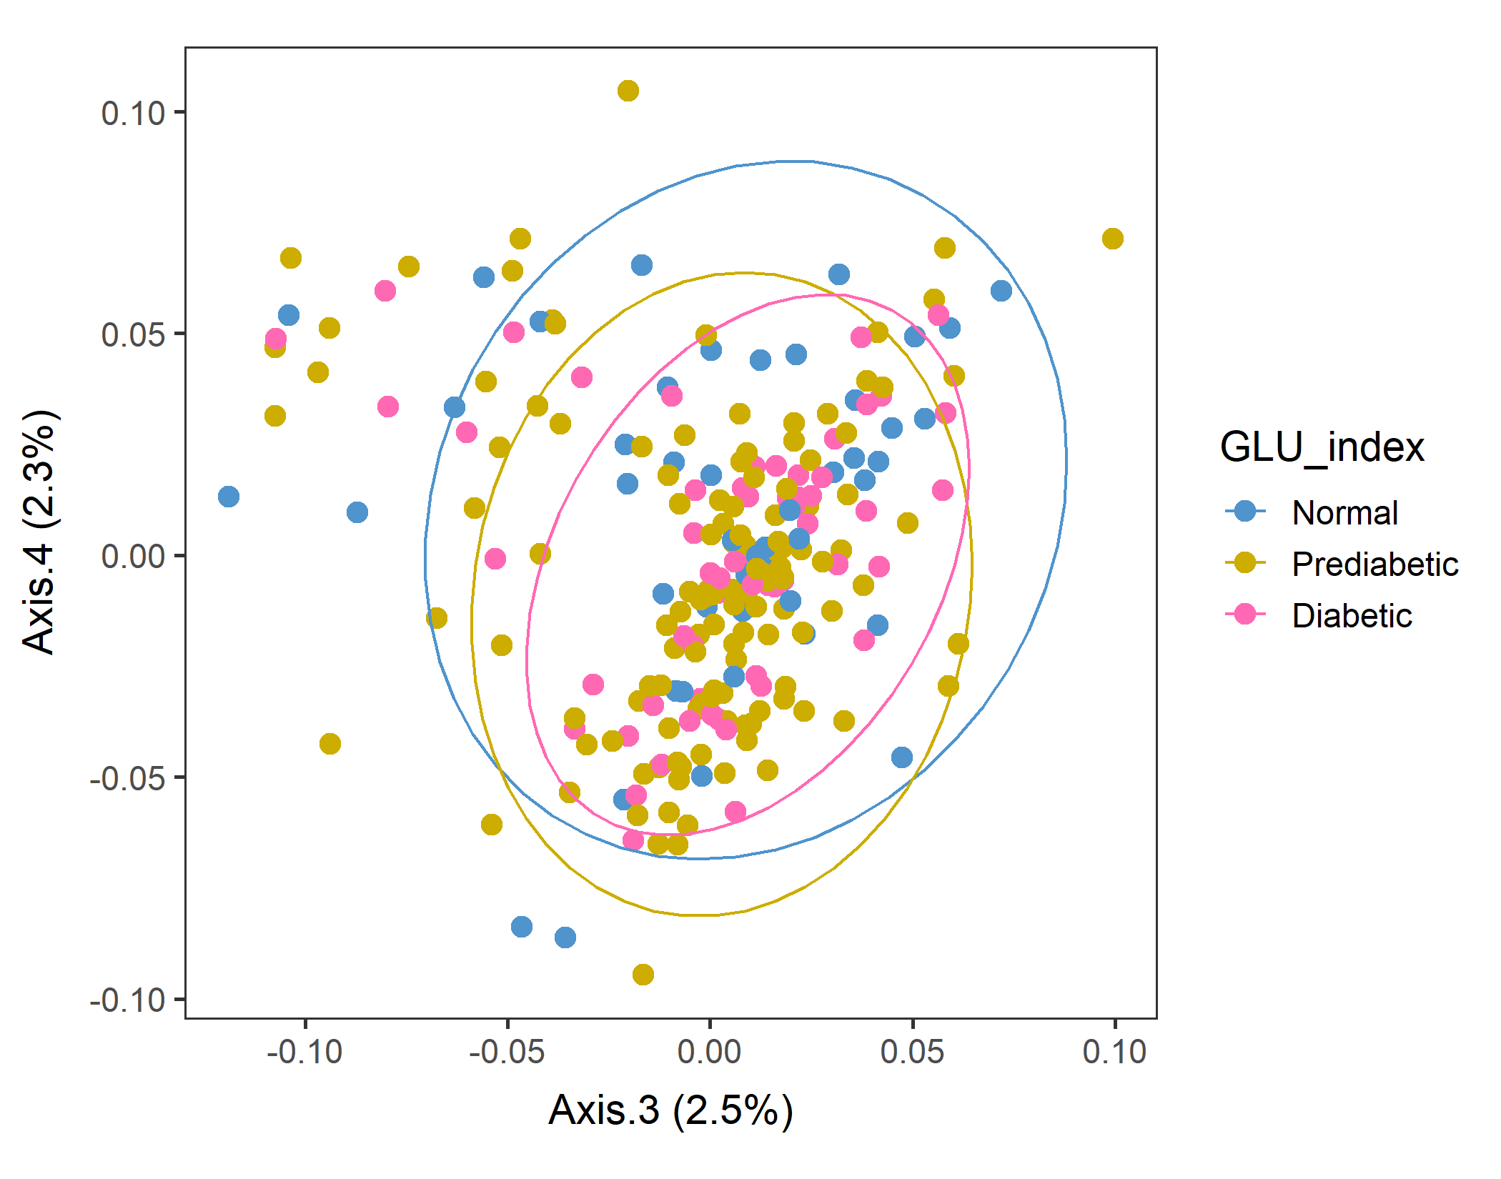
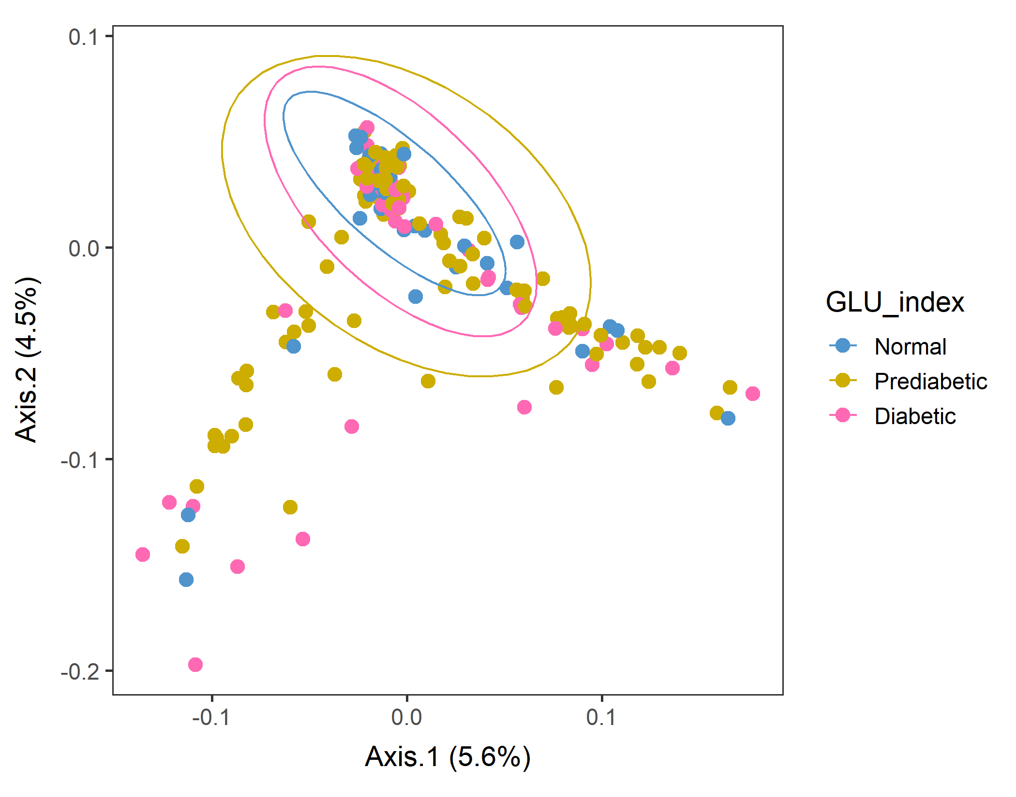
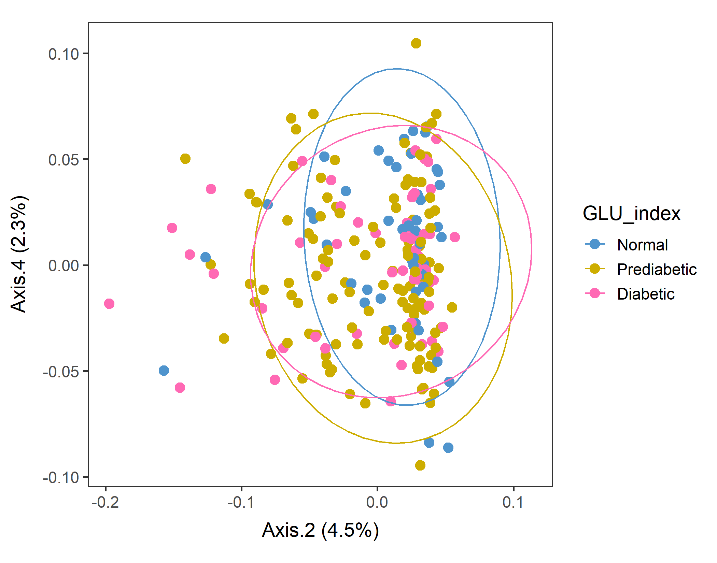
Male in 60-79 Lv3 PCoA with WEIGHTED unifrac distance
After sorting food by SEQN
Looks like Normal population tend to have a higher value of Axis.2.
Conversion failed
vegan::permutest: p-value ~0.05. Borderline, but assumption OK.
vegan::adonis: p-value 0.09. Groups are borderline but not different.

Slide 10
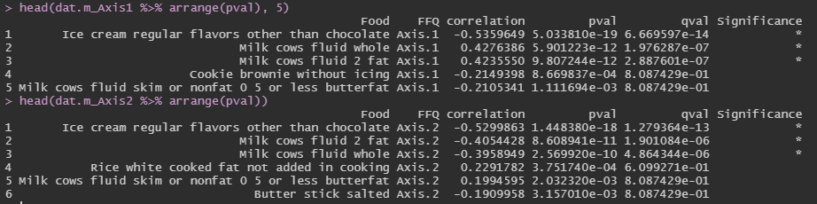
Corr between food groups and Axes: Axes 1 and 2
After sorting food by SEQN, males60to79, Lv3, WEIGHTED unifrac distance PCoA.
The foods that had the highest correlation with Axes 1&2 were almost the same – ice cream and milks. Banana foor Axis 1, and American cheese for Axis 2.

Slide 11
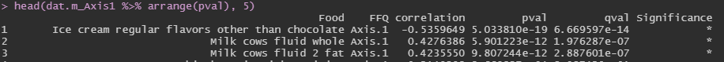
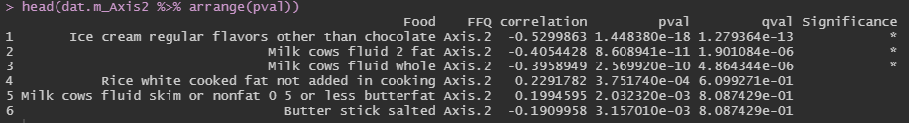
Corr between food groups and Axes. (heatmap) Axes 1 and 2
Axis 1 (+) and Axis 2 (–) …
Milk?
Axis 1 (–) and Axis 2 (–) …
Ice cream

Slide 12
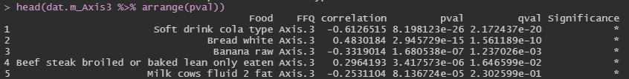
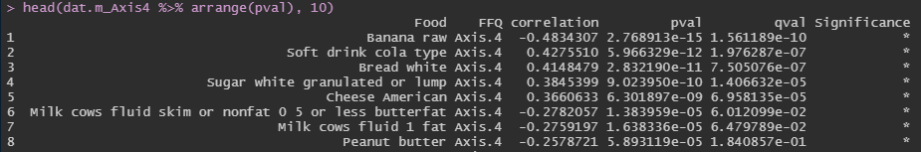
Corr between food groups and Axes: Axes 3 and 4
The foods that had the highest correlation with Axes 3&4 were – Soft drinks (Cola type), White bread, milk.
Also, White sugar and Cheese for Axis 4.
Axis 4 (+) were less healthy foods such as soft drinks, sugar, white bread, cheese.

Slide 13
Corr between food groups and Axes. (heatmap) Axes 2 and 3
Axis 3 (+) … White bread, lean beef steak
Axis 2 (–) were somewhat unhealthy dairy products such as ice cream, 2% or whole milk.
Prediabetic, and Diabetic groups shifting to less Axis 2 values. Makes sense accounting for their BMI…?
Axis 3 (–) … soft drink, raw banana, 2% milk
Axis 2 (+) … (rice, nonfat milk; not significant)
Axis 2 (-) … ice cream, 2%, whole milk

Slide 14
Corr between food groups and Axes. (heatmap) Axes 2 and 4
Axis 4 (+) … soft drinks, white bread, sugar, cheese
Axis 4 (+) were less healthy foods such as soft drinks, sugar, white bread, cheese, beer.
But GLU groups do not show much difference in the Axis 4 direction in Axis2&4 plot.
Axis 4 (–) … raw banana, nonfat or 1% milk, peanut butter
Axis 2 (+) … (rice, nonfat milk; not significant)
Axis 2 (-) … ice cream, 2%, whole milk

Slide 15

Corr between food groups and Axes.
When male subjects aged 60-79 were separated by their dietary patterns with weighted unifrac distance, ice cream was the key food category that separated them.. interesting.

Slide 16
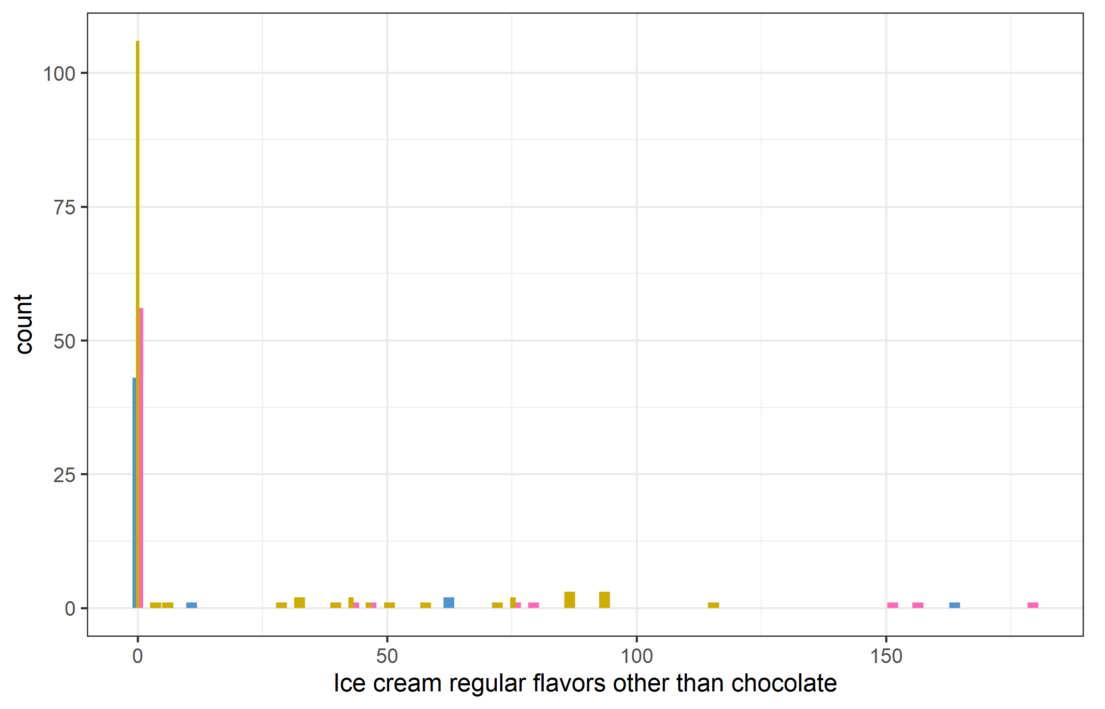
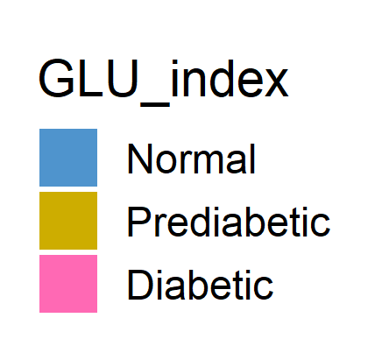
males60to79_red_Lv3_ord_WEIGHTED_corr_icecream_GLU
Food OTU table + GLU_index → plot “ice cream regular flavors other than chocolate” consumption and color code by GLU_index.
Most people did not consume ice cream, but some did. And most of them were either prediabetic or diabetic. That’s why the correlation was strong..

Slide 17
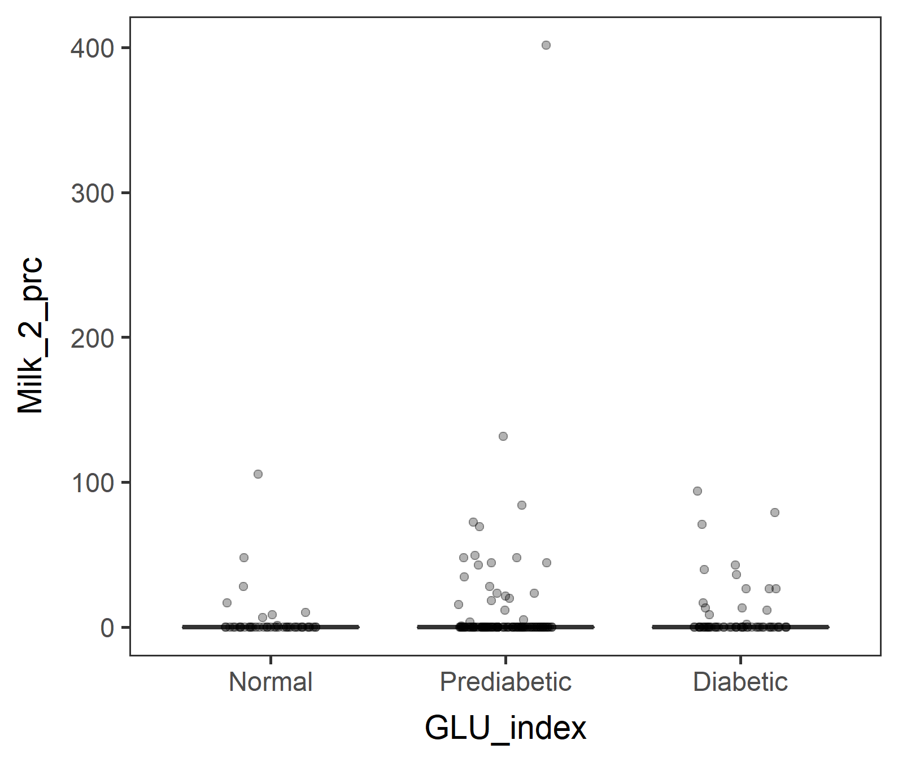
males60to79_red_Lv3_ord_WEIGHTED_corr_2%milk_GLU
Food OTU table + GLU_index → plot “Milk cows fluid 2 fat” consumption and color code by GLU_index.
Similarly to ice cream,
Most people did not consume 2% milk, but some did. And more prediabetic and diabetic people did.

Slide 18
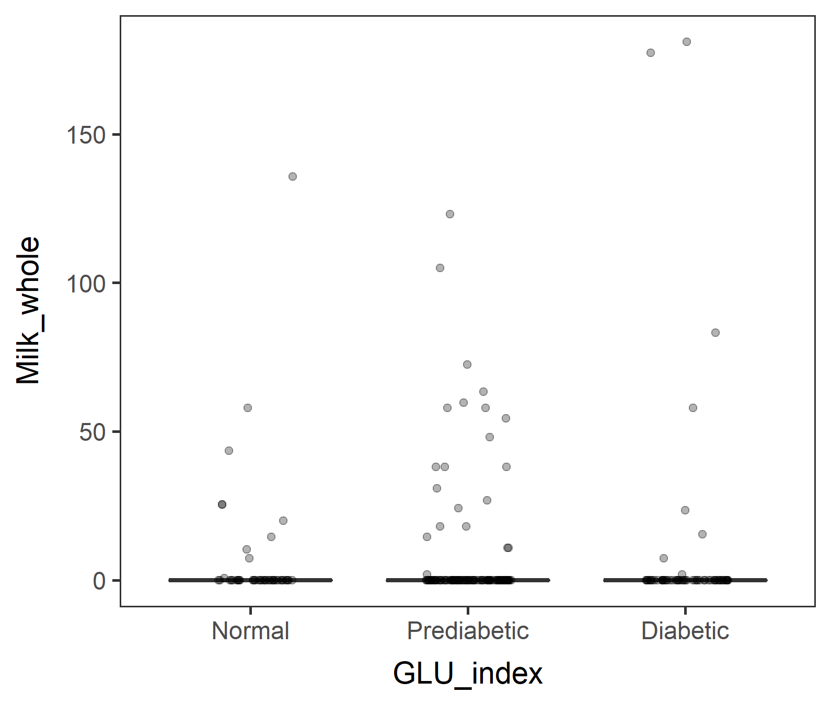

males60to79_red_Lv3_ord_WEIGHTED_corr_wholemilk_GLU
Food OTU table + GLU_index → plot “Milk cows fluid whole” consumption and color code by GLU_index.
Similarly to ice cream and 2% milk but difference not as obvious. Plus, Prediabetic group outnumbers Normal and Diabetic groups. That difference is accounted for…?

Slide 19
How to adjust sample size difference
Divide Prediabetic group into two – high and low. And make an argument that Prediabetic spectrum is a continuum.
OR
Bootstrapping - Random sampling of prediabetic

Slide 20


Divide Prediabetic group into two – high and low. (Make an argument that Prediabetic spectrum is a continuum.)
If 112.5 was the threshold, too many Prediabetic_L
If 110 was the threshold, well-balanced.
But it’s a bit strange to have thresholds of 100, 110, 126 for separating Normal, Prediabetic_L, Prediabetic_H, and Diabetic.
15_subset_NHANES_males60to79_PredLH.R

Slide 21

Male in 60-79 Lv3 PCoA with WEIGHTED unifrac distance
Try bootstrapping
(n=100)
Take random 55 samples from Prediabetic (total n=127)
|
Generate food tree, OUT table, tax table.
|
Generate phyloseq object
|
Ordination and save p-values of
adonis::bdisp,
adonis::vegan,
pairwise.adonis, only if adonis is significant. If not, “NA”.
 | dist.p | adonis.p
Mean | 0.068 | 0.210
Of the 100 runs, adonis was significant only 3 times, so pairwise comparison was done 3 times. but no pairs were different.
 | Dia_vs_Nor | Dia_vs_Pre | Pre_vs_Nor
Total | 0 | 0 | 0
Not different. Kind of expected.
At least I can provide the script (300 lines of a loop) for a simulation like this.

Slide 22
With Unweighted Unifrac Distance

Slide 23
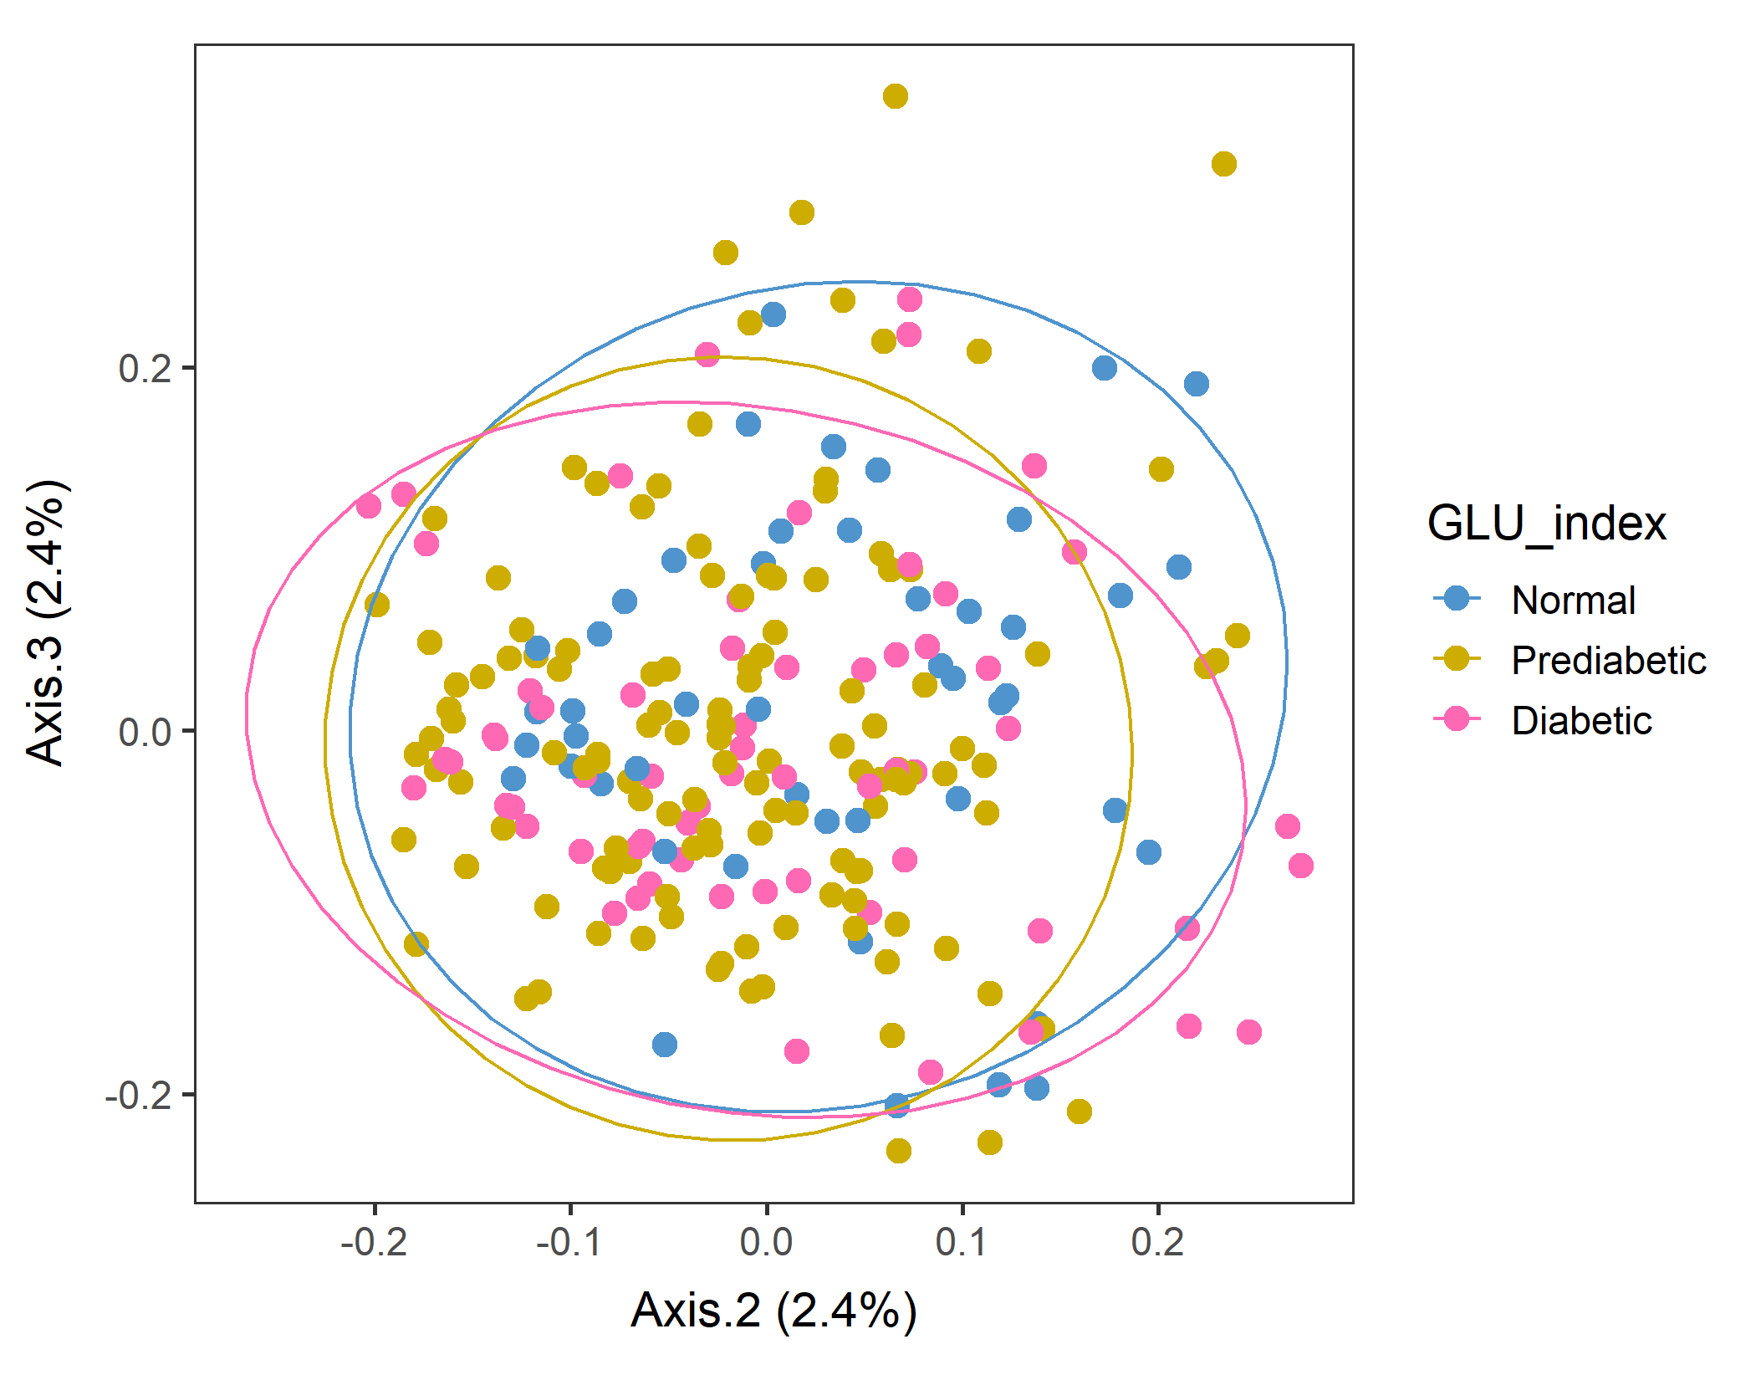
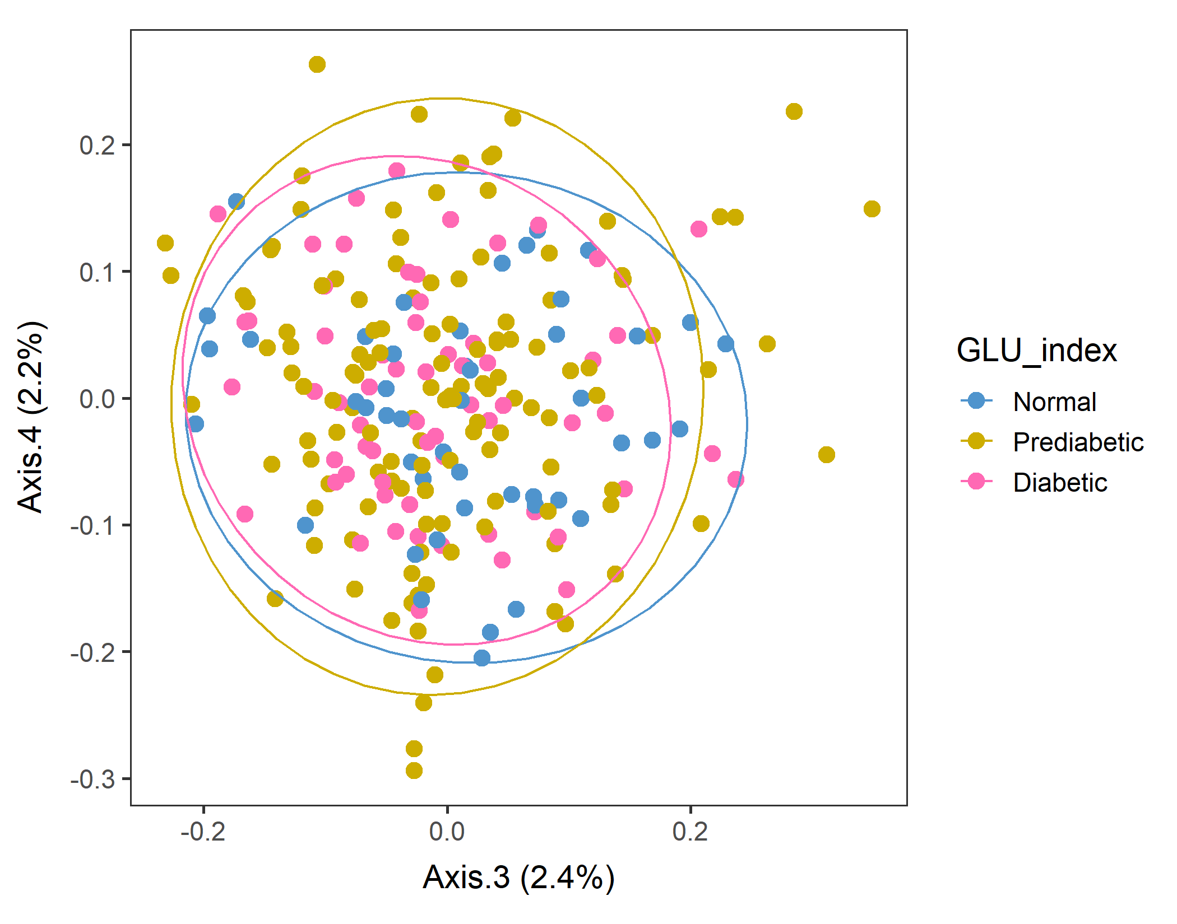
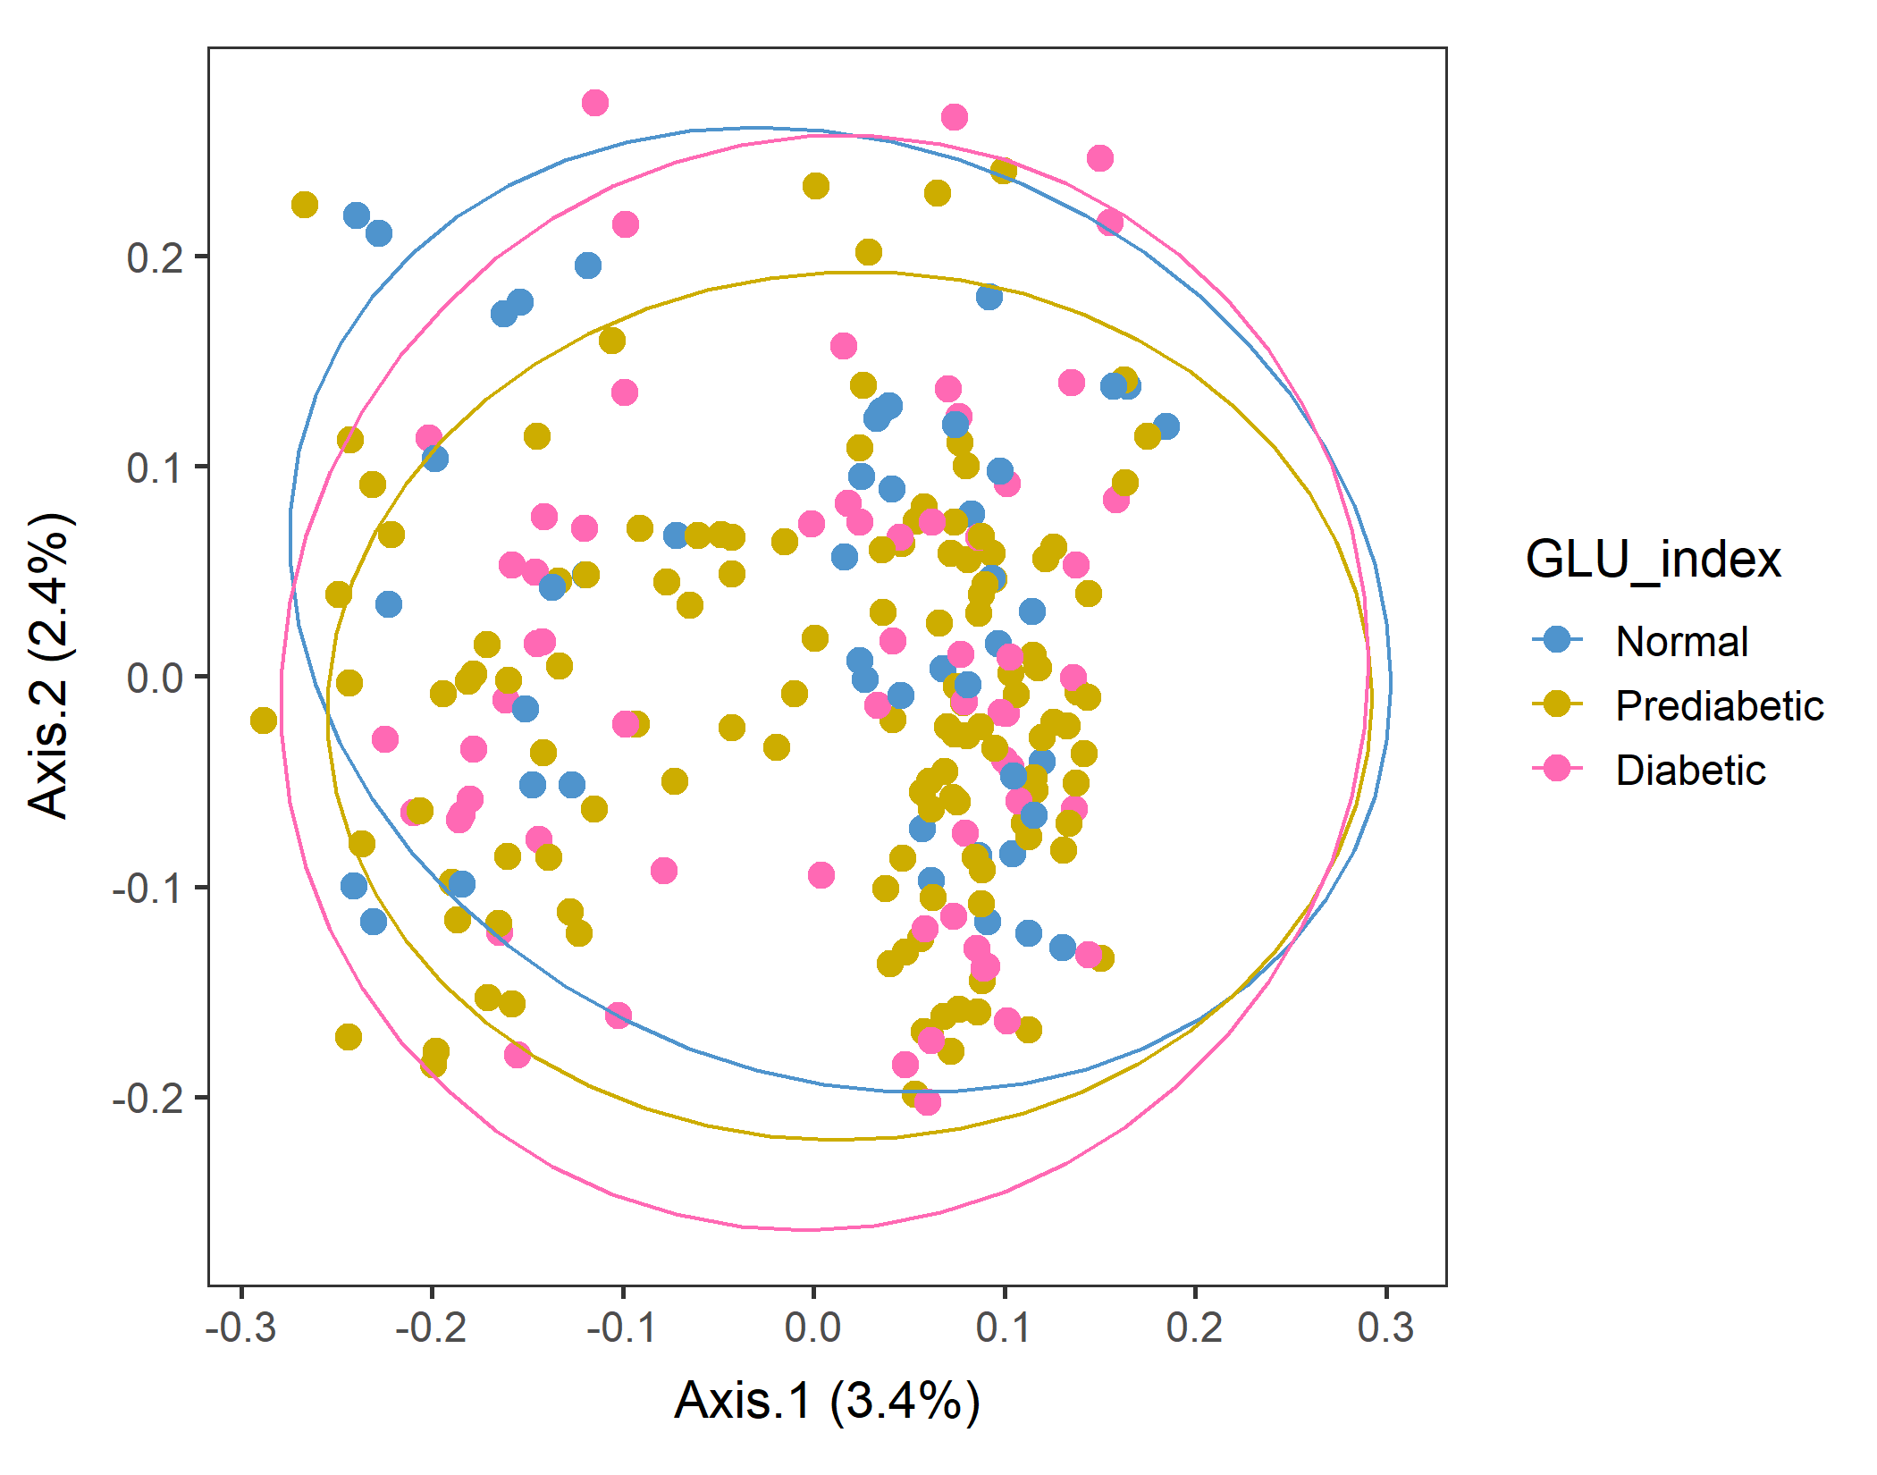
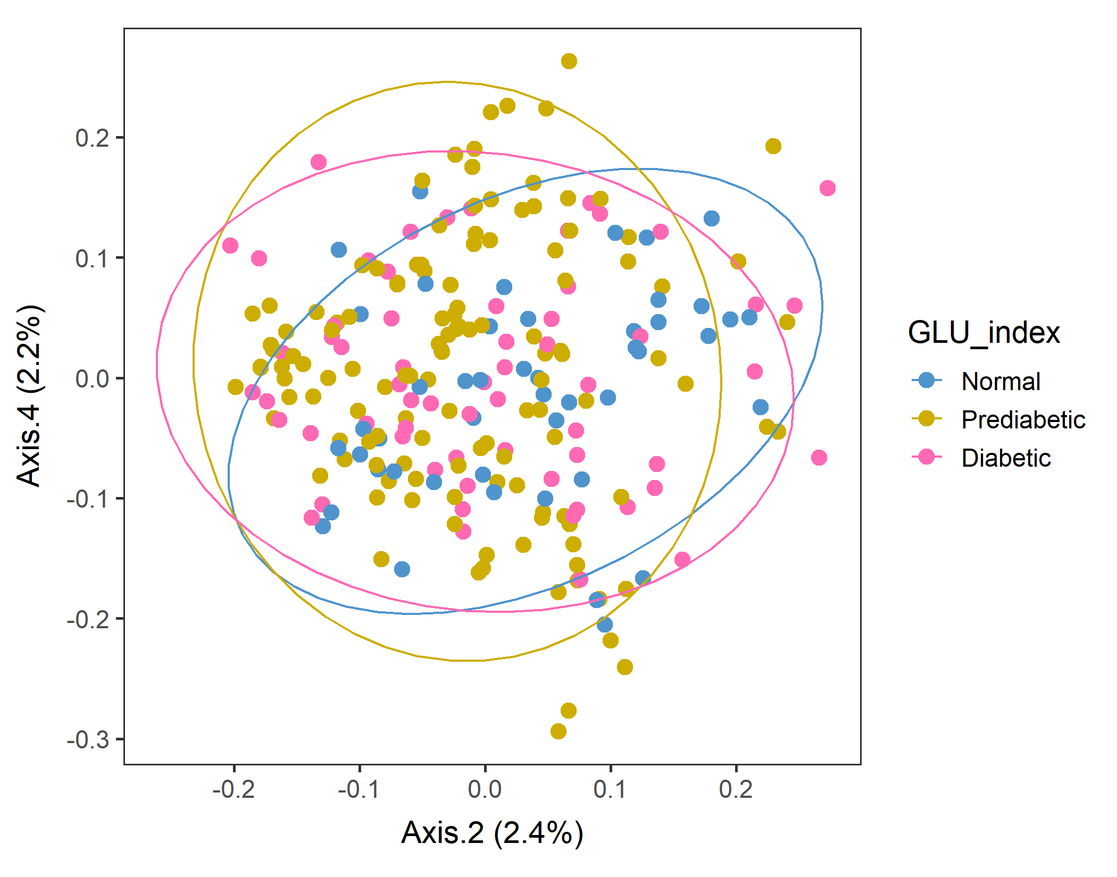
Male in 60-79 Lv3 PCoA with Unweighted unifrac distance
After sorting food by SEQN
Checked that ordination results are the same even after sorting SEQN columns in food object first. Though mirrored, but separation and % var explained are the same.
vegan::permutest: p-value ~0.6. Assumption OK.
vegan::adonis: p-value:0.07. Groups are borderline but not different.

Slide 24
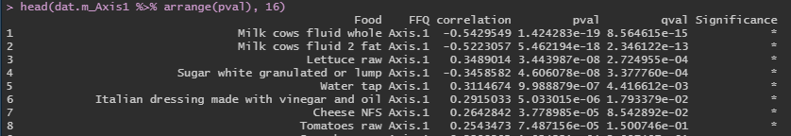
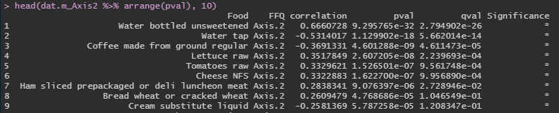
Corr between food groups and Axes: Axes 1 and 2
After sorting food by SEQN, males60to79, Lv3, UNweighted unifrac distance PCoA.
The foods that had the highest correlation with Axes 1 were milk, lettuce, white sugar, water, Italian dressing, cheese, tomatoes.
For axis 2: water, coffee, lettce, tomatoes, cheese, ham, wheat bread, cream substute

Slide 25
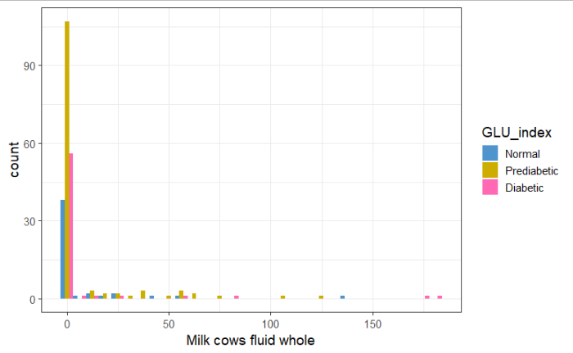
Whole milk consumed by Prediabetic and Diabetics more frequently
After sorting food by SEQN, males60to79, Lv3, UNweighted unifrac distance PCoA.
But again, the sample size difference is a confounding factor. Running a t-test might be useful

Slide 26
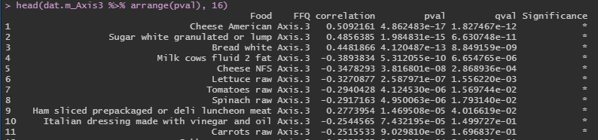
Corr between food groups and Axes: Axes 3
After sorting food by SEQN, males60to79, Lv3, UNweighted unifrac distance PCoA.
For axis 3: cheese, white sugar, white bread, milk, lettce, tomatoes, spinach, ham, Italian dressing, carrots.

Slide 27
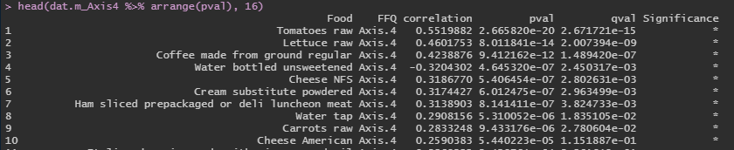
Corr between food groups and Axes: Axes 4
After sorting food by SEQN, males60to79, Lv3, UNweighted unifrac distance PCoA.
For axis 4: tomatoes, lettuce, coffee, water, cheese, cream substute, ham, carrots
Coffee and sandwich ingredients…?

Slide 28
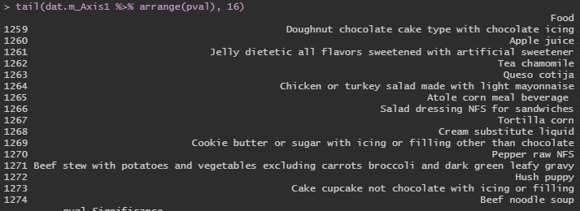
What are low correlation items?
After sorting food by SEQN, males60to79, Lv3, UNweighted unifrac distance PCoA.
Very specific dishes. Maybe because they are less frequently consumed..?
→Calculate the total consumption by colSums and compare it with correlation coeff?

Slide 29
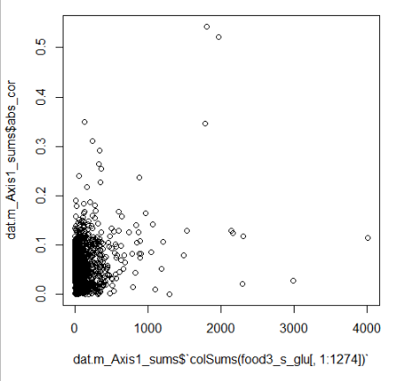
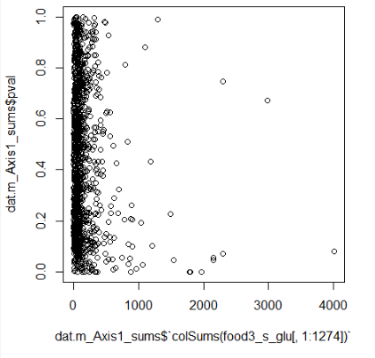
Calculate the total consumption by colSums and compare it with correlation coeff?
After sorting food by SEQN, males60to79, Lv3, UNweighted unifrac distance PCoA.
|corr coeff|
Milks
P-value
Lettuce
White sugar
Total food amount
Foods with high consumption amount has high correlation in general? – Not nececssarily.

Slide 30
Male in 60-79 Lv3 PCoA with Unweighted unifrac distance
Try bootstrapping to sample Prediabetic.
Take random 55 samples from Prediabetic (total n=127)
|
Generate food tree, OUT table, tax table.
|
Generate phyloseq object
|
Ordination and save p-values of
adonis::bdisp,
adonis::vegan,
pairwise.adonis, only if adonis is significant. If not, “NA”.
(n=10)
number | dist.p | adonis.p | <0.05
1 | 0.716 | 0.090
2 | 0.190 | 0.020 | *
3 | 0.068 | 0.014 | *
4 | 0.406 | 0.056
5 | 0.494 | 0.048 | *
6 | 0.094 | 0.003 | *
7 | 0.580 | 0.106
8 | 0.754 | 0.080
9 | 0.496 | 0.009 | *
10 | 0.640 | 0.021 | *
Mean | 0.444 | 0.045

Slide 31
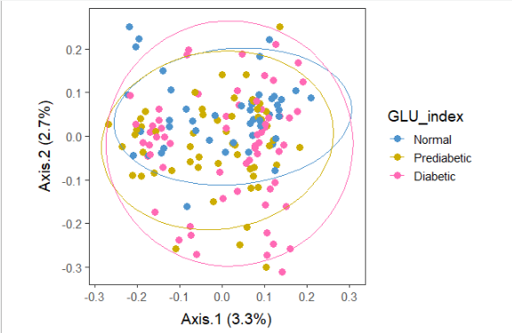
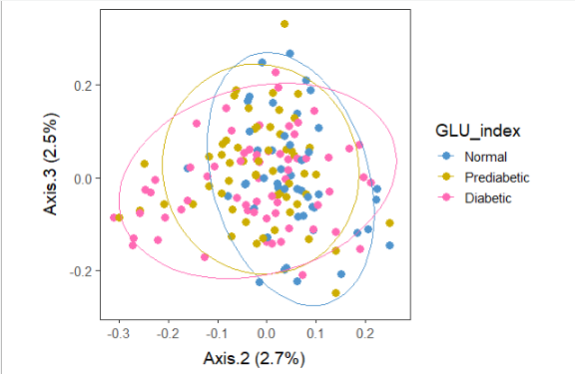
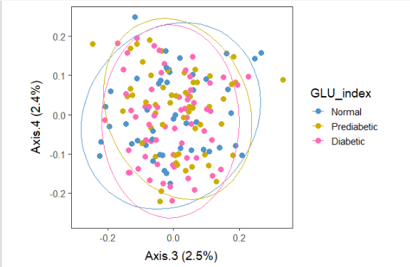
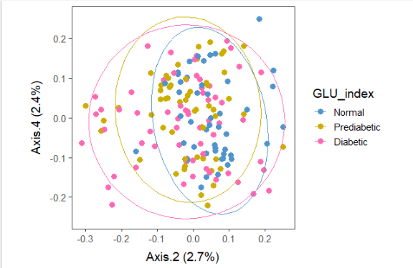
Male in 60-79 Lv3 PCoA with Unweighted unifrac distance
Try bootstrapping (n=10)
1 means the pair of comparison was different for each of the 10 runs.
Run 10 results where Diabetic and Normal groups were different.
number | Dia_vs_Nor | Dia_vs_Pre | Pre_vs_Nor
1 | NA | NA | NA
2 | 0 | 0 | 0
3 | 0 | 1 | 1
4 | NA | NA | NA
5 | 1 | 0 | 0
6 | 0 | 1 | 1
7 | NA | NA | NA
8 | NA | NA | NA
9 | 0 | 1 | 1
10 | 1 | 0 | 0
Total | 2 | 3 | 3

Slide 32
Male in 60-79 Lv3 PCoA with Unweighted unifrac distance
Try bootstrapping (n=100)
(n=100)
Of 100 runs, adonis was significant 50 times, so pairwise comparison was done 50 times.
 | dist.p | adonis.p
Mean | 0.426 | 0.070
1 means the pair of comparison was different for each of the 100 runs.
 | Dia_vs_Nor | Dia_vs_Pre | Pre_vs_Nor
Total | 25 | 8 | 8
Hmmmm… not conclusive, but at least I can provide the script (300 lines of a loop) for a simulation like this.
Can do more, only takes 20 sec/run.

